Slide 1
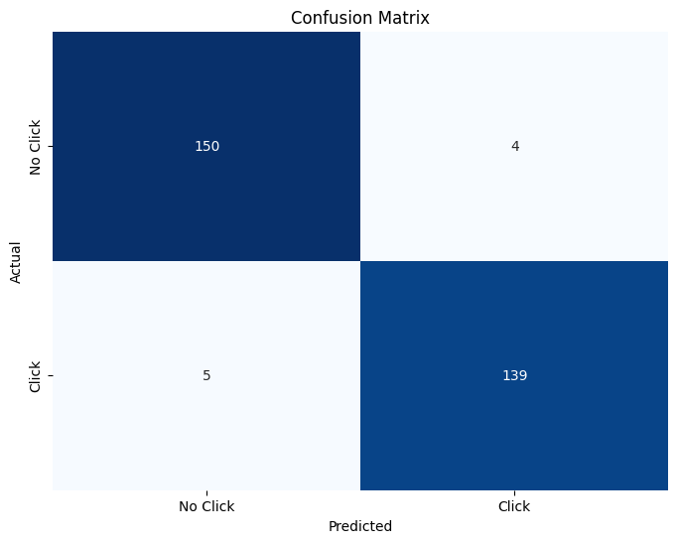
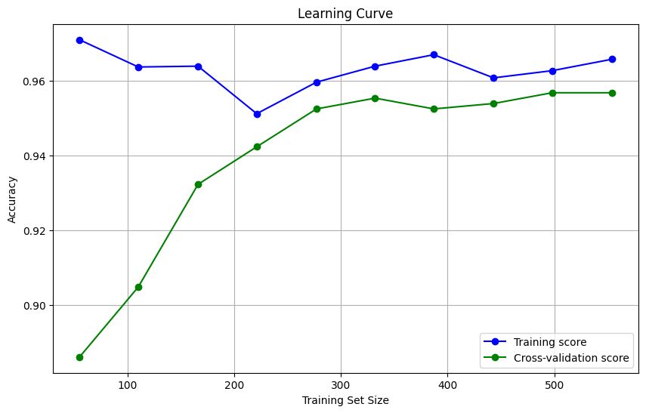
Data Modeling
Data Before Standardization
Logistic Regression
Result:
Best cross-validation score: 0.96
Accuracy (Test Set): 0.97
Accuracy (Train Set): 0.97
Precision (Test Set): 0.97
Recall (Test Set): 0.97
F1-Score (Test Set): 0.97
roc_auc (test-proba): 0.99
roc_auc (train-proba): 0.99
Accuracy (crossval train): 0.96
Accuracy (crossval test): 0.96
Untuk selengkapnya, dapat melihat google collab disini

Slide 2
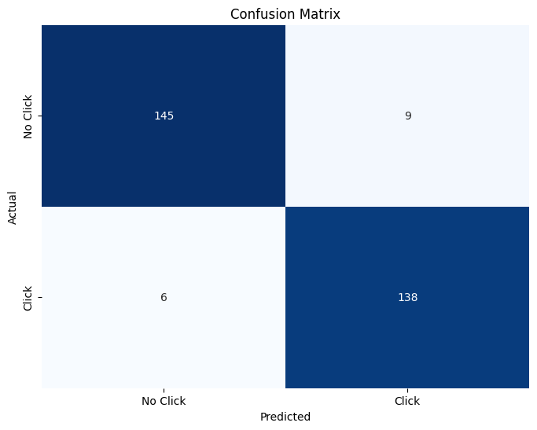
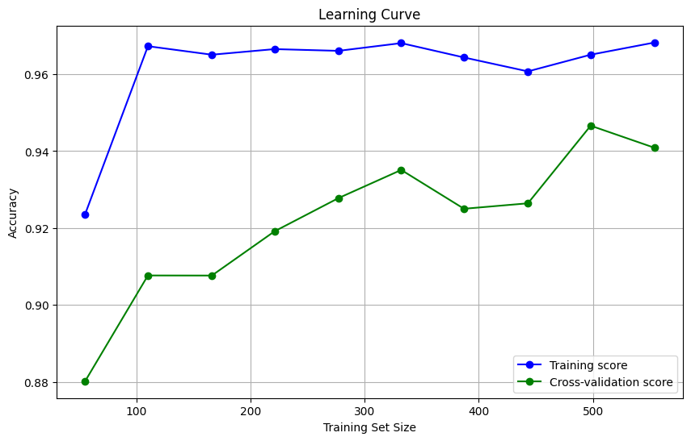
Data Modeling
Data Before Standardization
Decision Tree
Result:
Best cross-validation score: 0.94
Accuracy (Test Set): 0.95
Accuracy (Train Set): 0.97
Precision (Test Set): 0.94
Recall (Test Set): 0.96
F1-Score (Test Set):
0.95 roc_auc (test-proba): 0.98
roc_auc (train-proba): 1.00
Accuracy (crossval train): 0.94
Accuracy (crossval test): 0.92
Untuk selengkapnya, dapat melihat google collab disini

Slide 3

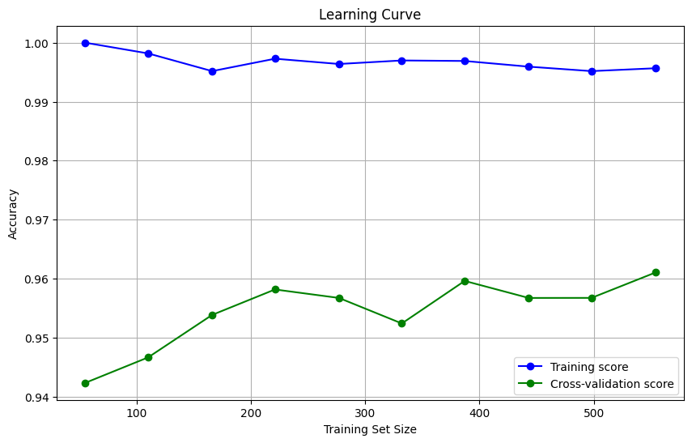
Data Modeling
Data Before Standardization
Random Forest
Result:
Best cross-validation score: 0.97
Accuracy (Test Set): 0.98
Accuracy (Train Set): 1.00
Precision (Test Set): 0.98
Recall (Test Set): 0.97
F1-Score (Test Set): 0.98
roc_auc (test-proba): 0.99
roc_auc (train-proba): 1.00
Accuracy (crossval train): 0.97
Accuracy (crossval test): 0.96
Untuk selengkapnya, dapat melihat google collab disini

Slide 4
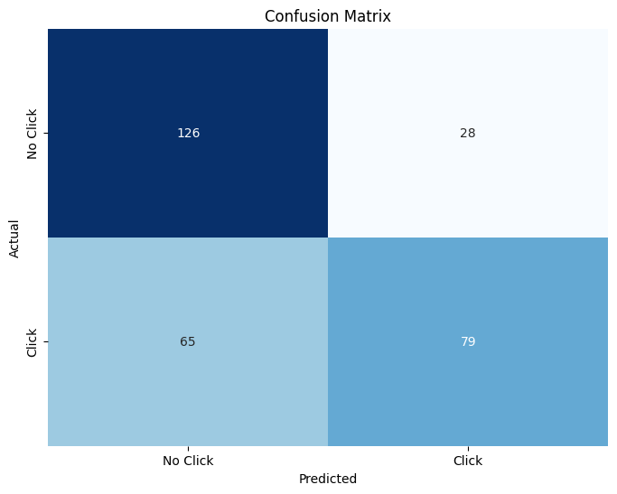
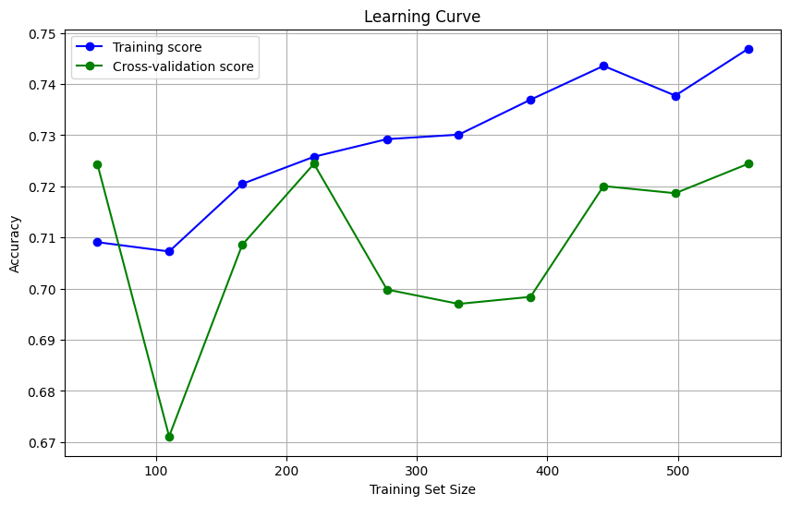
Data Modeling
Data Before Standardization
K – Nearest Neighbour
Result:
Best cross-validation score: 0.72
Accuracy (Test Set): 0.69
Accuracy (Train Set): 0.75
Precision (Test Set): 0.74
Recall (Test Set): 0.55
F1-Score (Test Set): 0.63
roc_auc (test-proba): 0.70
roc_auc (train-proba): 0.82
Accuracy (crossval train): 0.72
Accuracy (crossval test): 0.65
Untuk selengkapnya, dapat melihat google collab disini

Slide 5
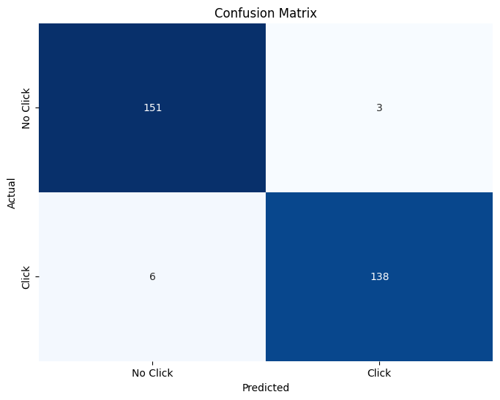
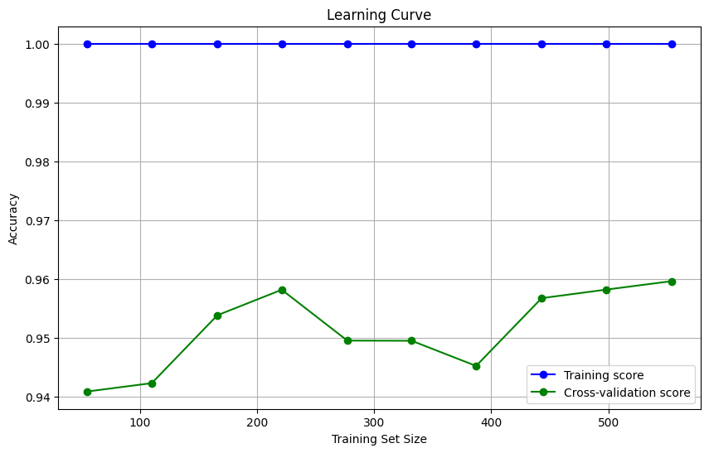
Data Modeling
Data Before Standardization
Gradient Boost Classifier
Result:
Best cross-validation score: 0.96
Accuracy (Test Set): 0.97
Accuracy (Train Set): 1.00
Precision (Test Set): 0.98
Recall (Test Set): 0.96
F1-Score (Test Set): 0.97
roc_auc (test-proba): 0.99
roc_auc (train-proba): 1.00
Accuracy (crossval train): 0.96
Accuracy (crossval test): 0.96
Untuk selengkapnya, dapat melihat google collab disini

Slide 6

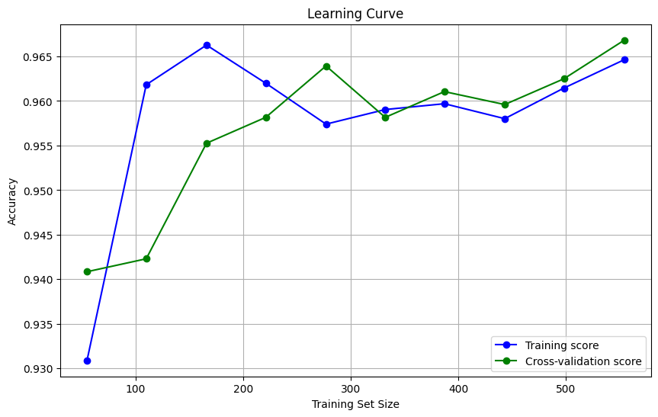
Data Modeling
Data After Standardization
Logistic Regression
Result:
Best cross-validation score: 0.97
Accuracy (Test Set): 0.98
Accuracy (Train Set): 0.97
Precision (Test Set): 0.99
Recall (Test Set): 0.97
F1-Score (Test Set): 0.98
roc_auc (test-proba): 0.99
roc_auc (train-proba): 0.99
Accuracy (crossval train): 0.97
Accuracy (crossval test): 0.97
Untuk selengkapnya, dapat melihat google collab disini

Slide 7
Data Modeling
Data After Standardization
Decision Tree
Result:
Best cross-validation score: 0.94
Accuracy (Test Set): 0.95
Accuracy (Train Set): 0.97
Precision (Test Set): 0.94
Recall (Test Set): 0.96
F1-Score (Test Set): 0.95
roc_auc (test-proba): 0.98
roc_auc (train-proba): 1.00
Accuracy (crossval train): 0.94
Accuracy (crossval test): 0.92
Untuk selengkapnya, dapat melihat google collab disini

Slide 8

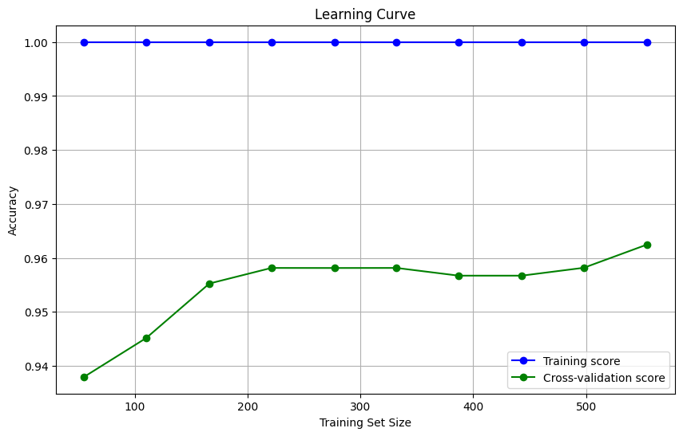
Data Modeling
Data After Standardization
Random Forest
Result:
Best cross-validation score: 0.96
Accuracy (Test Set): 0.97
Accuracy (Train Set): 1.00
Precision (Test Set): 0.97
Recall (Test Set): 0.97
F1-Score (Test Set): 0.97
roc_auc (test-proba): 0.99
roc_auc (train-proba): 1.00
Accuracy (crossval train): 0.96
Accuracy (crossval test): 0.96
Untuk selengkapnya, dapat melihat google collab disini

Slide 9

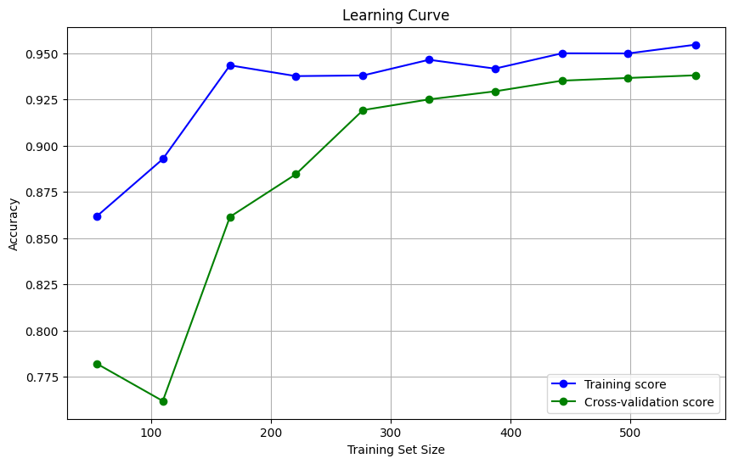
Data Modeling
Data After Standardization
K – Nearest Neighbour
Result:
Best cross-validation score: 0.94
Accuracy (Test Set): 0.95
Accuracy (Train Set): 1.00
Precision (Test Set): 0.98
Recall (Test Set): 0.92
F1-Score (Test Set): 0.95
roc_auc (test-proba): 0.98
roc_auc (train-proba): 1.00
Accuracy (crossval train): 0.94
Accuracy (crossval test): 0.93
Untuk selengkapnya, dapat melihat google collab disini

Slide 10
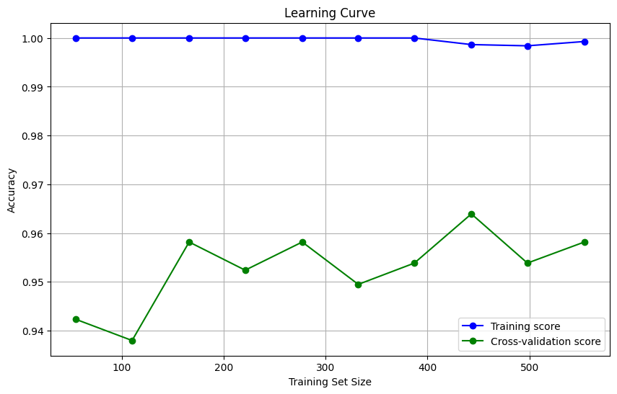
Data Modeling
Data After Standardization
Gradient Boost Classifier
Result:
Best cross-validation score: 0.96
Accuracy (Test Set): 0.97
Accuracy (Train Set): 1.00
Precision (Test Set): 0.97
Recall (Test Set): 0.97
F1-Score (Test Set): 0.97
roc_auc (test-proba): 0.99
roc_auc (train-proba): 1.00
Accuracy (crossval train): 0.96
Accuracy (crossval test): 0.96
Untuk selengkapnya, dapat melihat google collab disini

Slide 11
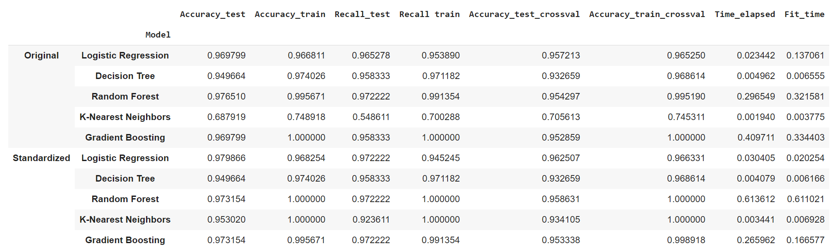
Data Modeling
Comparison Model
Key Takeaways:
Best model untuk data yang tidak di standarisasi adalah Random Forest
Best model untuk data di standarisasi adalah Logistic Regression
Untuk selengkapnya, dapat melihat google collab disini

Slide 12
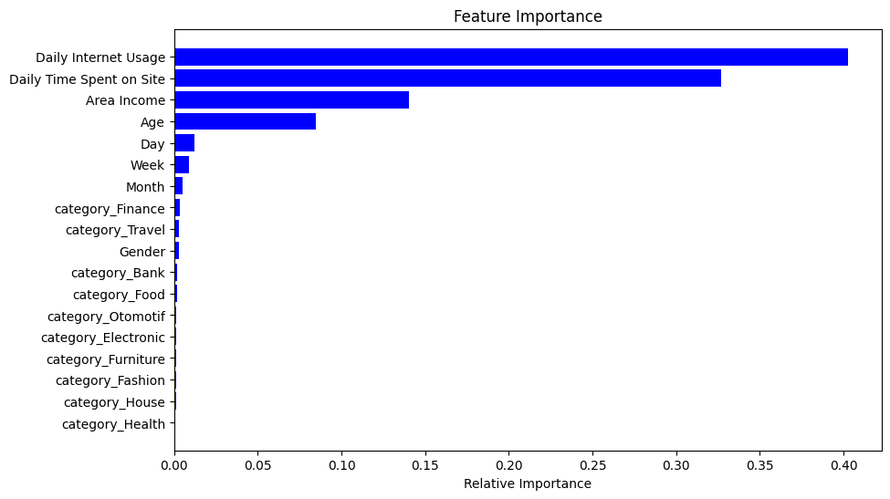
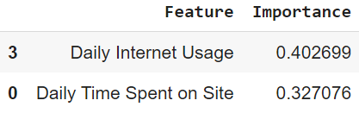
Data Modeling
Feature Importance Data Before Standardization
Key Takeaways:
Berdasarkan chart feature importance dari modelling data yang belum di standarisasi, diketahui bahwa feature Daily Internet Usage dan Daily Time Spent on Site adalah fitur yang paling mempengaruhi model.
Untuk selengkapnya, dapat melihat google collab disini

Slide 13
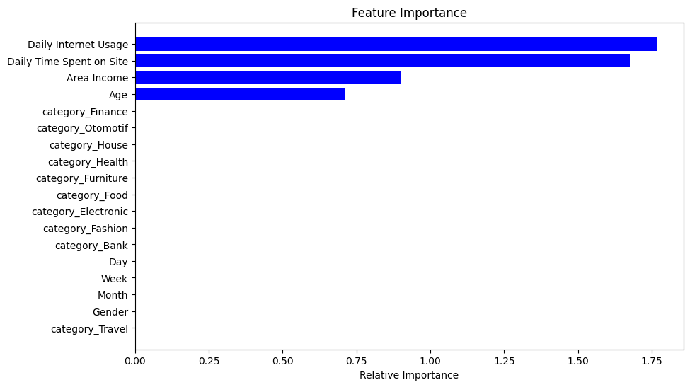
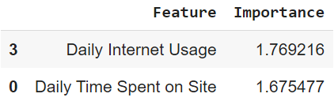
Data Modeling
Feature Importance Data After Standardization
Key Takeaways:
Berdasarkan chart feature importance dari modelling data yang di standarisasi, diketahui bahwa feature Daily Internet Usage dan Daily Time Spent on Site adalah fitur yang paling mempengaruhi model.
Untuk selengkapnya, dapat melihat google collab disini

